Slide 1
Slides for Chapter 4
Note to Instructors
This Keynote document contains the slides for “A Journey of a Thousand Miles”, Chapter 4 of Explorations in Computing: An Introduction to Computer Science and Python Programming.
The book invites students to explore ideas in computer science through interactive tutorials where they type expressions in Python and immediately see the results, either in a terminal window or a 2D graphics window.
Instructors are strongly encouraged to have a Python session running concurrently with Keynote in order to give live demonstrations of the Python code shown on the slides.
License
The slides in this Keynote document are based on copyrighted material from Explorations in Computing: An Introduction to Computer Science and Python Programming, by John S. Conery.
These slides are provided free of charge to instructors who are using the textbook for their courses.
Instructors may alter the slides for use in their own courses, including but not limited to: adding new slides, altering the wording or images found on these slides, or deleting slides.
Instructors may distribute printed copies of the slides, either in hard copy or as electronic copies in PDF form, provided the copyright notice below is reproduced on the first slide.
© 2015 John S. Conery

Slide 2
A Journey of a Thousand Miles
Iteration as a strategy for solving computational problems
Searching and Sorting
The Linear Search Algorithm
The Insertion Sort Algorithm
Scalability

Slide 3
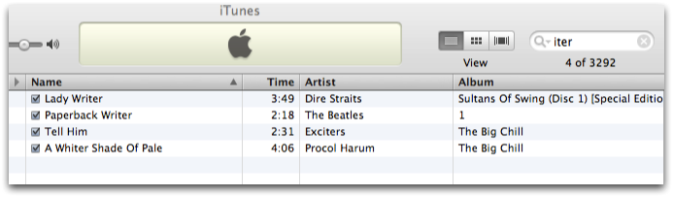
Search
Searching is a common operation in many different applications
in iTunes, enter a string in the “search box”
the program shows tunes that have that string in the song title, album title, artist name, or other fields

Slide 4
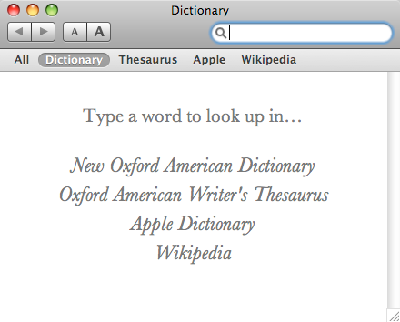
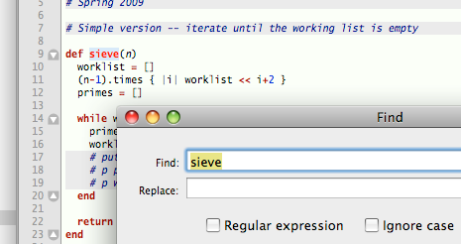
Search (cont’d)
Some other examples:
on-line dictionaries and catalogs
the “find” command in a word processor or text editor
Dictionary.app on Mac OS X systems
Find command in TextMate

Slide 5

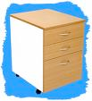

Defining Search
The examples on the previous slides were similar to searches in everyday life
look for a book, either on a bookshelf at home or in a library
find a name in a phone book or a word in a dictionary
search a file drawer to find customer information or student records
What these problems have in common:
we have a large collection of items
we need to search the collection to find a single item that matches a certain condition (e.g. name of book, name of a person)

Slide 6
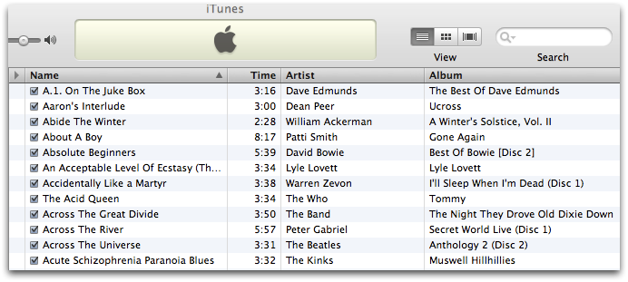
Sorting
Sorting -- reorganizing information so it’s in a particular order -- is closely relating to searching
Click a column name to sort by that field

Slide 7
Iterative Algorithms
The goal for this chapter: study two new algorithms based on iteration
Build on the main idea from Chapter 3:
repeating (iterating) a series of small steps can lead to the solution of important problems
Search algorithm:
linear search
Sort algorithm:
insertion sort
The next chapter looks at more sophisticated techniques for both searching and sorting

Slide 8
IterationLab
The lab module for this chapter is IterationLab
At the beginning of each interactive session for projects in this chapter:
>>> from PythonLabs.IterationLab import *
The module has
implementations of linear search and insertion sort
functions that use algorithm animation to view the progress of the algorithms
>>> notes = ['do', 're', 'me', 'fa', 'sol', 'la', 'ti']
>>> isort(notes)
>>> notes ['do', 'fa', 'la', 'me', 're', 'sol', 'ti']
The function that implements insertion sort is called isort

Slide 9
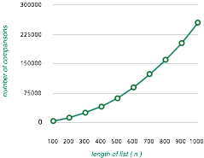
Chapter Outline
Do some experiments with the searching and sorting functions implemented in IterationLab
make random lists of strings and numbers
monitor the progress of the algorithms on the PythonLabs canvas
Write our own implementations of the two algorithms
these programming projects help introduce some new Python constructs
Do some experiments with large lists of numbers
measure the performance of the algorithms when they operate on lists with thousands of items

Slide 10
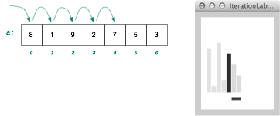
Linear Search
Linear search is the simplest, most straightforward search strategy
As the name implies, the idea is to start at the beginning of a collection and compare items one after another
Some terminology:
this type of search is also sometimes called a scan
if the key is not found the search fails

Slide 11
Linear Search in Python
In Chapter 3 we saw that Python uses lists to hold collections of data
>>> a = [8, 0, 9, 2, 7, 5, 3]
>>> type(a) <class 'list'>
The in operator does a linear search to see if an item is in a list
>>> 7 in a True
>>> 4 in a False

Slide 12
The index Method
If we want to know where an item is located we can use the index method
>>> notes = ['do', 're', 'me', 'fa', 'sol', 'la', 'ti']
>>> notes.index('fa') 3
However if an item is not in a list the method generates an error
>>> notes.index('bzzt') ValueError: 'bzzt' is not in list
Recall that when a list has n items the indexes are 0 to n - 1

Slide 13
isearch
The linear search function in IterationLab is like Python’s index method
pass it a list and an item to search for
if the item is in the list the function returns the location where it was found
if the item is not in the list the function returns None
>>> notes ['do', 're', 'me', 'fa', 'sol', 'la', 'ti']
>>> isearch(notes, 'fa') 3
>>> isearch(notes, 'bzzt')
>>> isearch(notes, 'ti') 6
In an interactive session, if a function returns None Python doesn’t print anything

Slide 14
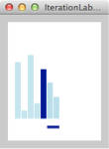
Visualization
A function called view_list draws a set of bars for the items in a list
the height of a bar is proportional to the value of the item
If a list is on the canvas the display is updated as isearch looks for an item
As the search progresses the item being compared is highlighted

Slide 15
RandomList
In our experiments on searching and sorting algorithms we’re going to need some data to test our programs
The lab module defines a special type of list called a RandomList
we can make lists of integers or strings
the list will not contain any duplicates
when we do a search we can use items we know are in the list (so the search succeeds) or not in the list (so the search fails)
>>> a = RandomList(10)
>>> a [11, 25, 97, 89, 72, 12, 59, 3, 86, 61]
>>> fish = RandomList(5, ‘fish')
>>> fish ['yellowfin', 'tuna', 'sockeye', 'piranha', 'grouper']

Slide 16
Choosing an Item to Search For
After we make a RandomList object we can ask it to give us an item to search for
We will want to do experiments with both successful and unsuccessful searches
>>> fish ['yellowfin', 'tuna', 'sockeye', 'piranha', ‘grouper']
>>> fish.random('success')
'sockeye'
>>> fish.random('success')
'grouper'
>>> fish.random('fail') 'catfish'
>>> fish.random('fail') 'dory'
The RandomList object from the previous slide
The method named random is defined for a RandomList but not for a regular Python list
Pass ‘success’ or ‘fail’ to tell the method you want an item that is or is not in the list

Slide 17
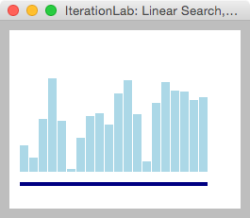
Experiments with isearch
Make a list of random integers
>>> a = RandomList(20)
Print the list in the terminal window
>>> a [27, 13, 55, 99, … 76, 79]
Display the list on the canvas
>>> view_list(a)
The visualization only works for lists of numbers
Do the heights of the bars correspond to the numbers in the list?

Slide 18
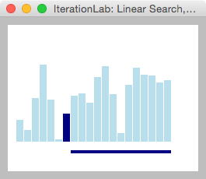
Experiments with isearch (cont’d)
Try a successful search
>>> x = a.random('success')
>>> x 35
>>> isearch(a, x) 6
In this example the item was found at location 6
The highlighted bar is the value we searched for

Slide 19
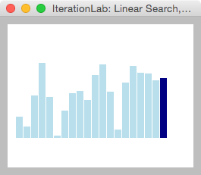
Experiments with isearch (cont’d)
Try an unsuccessful search
>>> isearch(a, a.random('fail'))
The algorithm scans the entire list before returning None

Slide 20
Implementing Linear Search
One way to write our own version of isearch is to use a for statement with a range expression
If the item is found the return statement on line 5 tells Python to exit the loop and return before the iteration is done
If the item is not in the list the loop terminates and the statement on line 6 is executed
A linear search using a for statement

Slide 21
while Loops
The index variable i must be initialized before the while statement
Another way to write the function is shown at right
This iteration is controlled by a while statement
Python evaluates the Boolean expression next to the keyword while
if the expression is True the statements in the body of the loop are executed
Python then goes back to to top of the loop to evaluate the Boolean expression again
the loop terminates when the expression is False
Important! make sure the loop contains a statement that updates i
If i never changes the program will be caught in an infinite loop

Slide 22
while or for?
Why does Python give us two ways to write loops?
for loops are convenient but some algorithms need to look at items in a different order
binary search (described in the next chapter) is a good example: the first item to compare is in the middle of the list
Advice: unless there is a good reason to use a while statement write your loops with for statements
Python takes care of initializing and updating the index variable
programs will be shorter and less likely to contain errors
i = 0
while i < len(a):
...
i += 1
for i in range(len(a)):
...
When we use a while loop we have to write 3 statements instead of 1

Slide 23
Performance
How many comparisons will the linear search algorithm make as it searches through a list with n items?
another way to phrase it: how many iterations will our Python function make?
For an unsuccessful search:
compare every item before returning None
i.e. make n comparisons
For a successful search, anywhere between 1 and n
search may be lucky and find the item in the first location
at the other extreme the item might be in the last location
expect, on average, n / 2 comparisons

Slide 24
Recap: Linear Search
The linear search algorithm looks for an item in a list
start at the beginning (a[0], or “the left”)
compare each item, moving systematically to the right (i += 1)
Performance when searching a list of n items:
do n comparisons when the search is unsuccessful
expect an average of n/2 comparisons for a successful search

Slide 25

Sorting
The search algorithm shown on the previous slides is an example of an iterative algorithm
start at the beginning of a collection
systematically progress through the collection, all the way to the end if necessary
A similar strategy can be used to sort the items in a list
The next set of slides will introduce a very simple sorting algorithm known as insertion sort
Basic idea: pick up an item, find the place it belongs, insert it back into the list
Move to the next item and repeat

Slide 26
Insertion Sort
The important property of the insertion sort algorithm: at any point in this algorithm part of the list is already sorted
For example, suppose we’re sorting a set of playing cards
when it is time to find a place for the J in this hand all the cards to the left are in order
pick up the J and find where it belongs in the group to the left and insert it back into the hand

Slide 27
Insertion Sort
Here is a more precise statement of insertion sort with a hand of cards
the initial item to work on is at the second location in the list (the Q in this example)
use your left hand to pick up the current item
scan left until you find an item lower than the one in your left hand, or the front of the list, whichever comes first
insert the item back into the list at this location
the next item to work on is to the right of the location of the item
go back to step 2
This new version is precise enough that we can use it as the outline of a Python function that will a sort a list of any type of object

Slide 28
Insertion Sort in Python
Here is the insertion sort function, with a few things still left to fill in:
def isort(a):
i = 1
while i < len(a):
x = a[i]
remove x from a
j = location for x
insert x at a[j+1]
end
Example:
• when i = 3 x will be “J”
• j will be set to 0 (since a[0] = “9” is the first location with a card smaller than “J”)
• “J” will be inserted at location 1

Slide 29
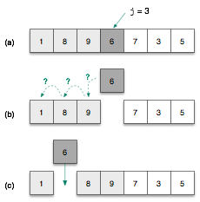
Insertion Sort Example
The following pictures show an example of how insertion sort works (using a list of numbers instead of cards)
when we’re working on them item in location 3 the positions to the left (0 through 2) have been sorted
the statements in the body of the loop find the new location for this item and insert it back into the list
The sorted region (light gray squares) grows by one item

Slide 30
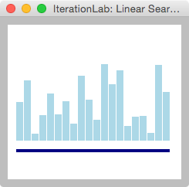
Visualization
To watch isort in action, create a list of numbers and display it on the canvas
>>> a = RandomList(20)
>>> view_list(a)
The horizontal bar at the bottom of the canvas is the unsorted region of the list
think of it as a “to do” list: it contains the items not yet sorted

Slide 31
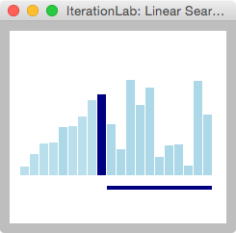
Visualization (cont’d)
Call isort and pass it the list
>>> isort(a)
as the list is sorted you will see an item pulled out of the list and reinserted somewhere to the left
you will also see the unsorted region shrink
The algorithm terminates when all the items have been moved, i.e. when the unsorted region is empty
Control the speed of the visualization by setting the time (in seconds) between steps in the animation:
>>> Canvas.delay = 0.1

Slide 32
Moving Items in a List
In order to implement the steps in the body of the main loop we need to know:
how to remove an item from the middle of a list
how to insert an item into a list
Both operations are performed by methods in the list class
Call a.pop(i) to delete the item at location i in list a
the method returns the item that was deleted
Call a.insert(i, x) to insert x into the list a at location i
Examples on the next slide

Slide 33
Moving Items in a List (cont’d)
>>> a = RandomList(7, 'elements')
>>> a ['Cr', 'Lu', 'Pa', 'Y', 'N', 'Kr', 'Ta']
>>> x = a.pop(4)
>>> x 'N'
>>> a ['Cr', 'Lu', 'Pa', 'Y', 'Kr', ‘Ta']
>>> a.insert(2,x)
>>> a ['Cr', 'Lu', 'N', 'Pa', 'Y', 'Kr', ‘Ta']
Create a list of 7 strings
This call to pop removes the string at location 4 and saves it in x
Note the list has 6 items now
This call to insert puts x back into the list at location 2

Slide 34
Finding Where an Item Belongs
After we pull an item out of the list we have to find the location to re-insert it
We’ll use an index variable j to specify which locations we are checking
Subtracting 1 from j will tell Python to move left during its search
A while loop keeps subtracting 1 from j until it finds the place where item x belongs
while a[j-1] > x:
j = j - 1
(preliminary version)

Slide 35
Finding Where an Item Belongs (cont’d)
There is a potential problem with this strategy: what if x is smaller than everything to its left?
The loop will reach a point where j = 0 and there is nothing left to compare
it will try to compare x to a[-1], which is an error
The solution is to keep iterating only if j > 0 and the item to the left is greater than x
while j > 0 and a[j-1] > x:
j = j - 1
(final version)

Slide 36
Helper Function
A function that contains the previous operations (remove an item, find a location, re-insert the item) is shown below
A call to
move_left(a,j)
will remove the item at a[j] and place it back in a where it belongs
A special-purpose function that is written to solve a small piece of a larger problem is called a helper function
Create a file named isort.py and add this definition

Slide 37
Testing the Helper Function
Start an interactive Python session and import your definition of the helper function
>>> from isort import *
Create a list of numbers like the one shown at right and call move_left to find the location for the number at a[3]
>>> a = [1,8,9,6,7,3,5]
>>> move_left(a,3)
>>> a [1, 6, 8, 9, 7, 3, 5]
Note how the sorted region (light gray squares) grows by one item after a call to move_left

Slide 38
The Complete isort Function
Now that we have a helper function to move items writing isort is easy
Use a for loop where an index variable i marks the start of the unsorted region
initially i will be 1 (the single item at a[0] is a sorted region of size 1)
in the body of the loop just call move_left to move the item at location i
isort is the top-level function called to solve the entire problem

Slide 39
Performance
We saw earlier that for a list with n items we can expect, on average, to do n / 2 comparisons during a linear search
Can we come up with a similar equation for isort?
At first glance it might seem that insertion sort is a “linear” algorithm like isearch
it has a for loop that progresses through the list from left to right
But it’s important to note what is happening inside the move_left helper function
the step that finds the proper location for the current item is also a loop
it scans left from location i, going all the way back to 0 if necessary

Slide 40
Nested Loops
If we write isort without a helper function we can see one loop inside the other
def isort(a):
for i in range(1, len(a)):
j = i
x = a.pop(j)
while j > 0 and a[j-1] > x:
j -= 1
a.insert(j, x)
The while loop in move_left
An algorithm with one loop inside another is said to have nested loops

Slide 41
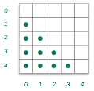
Nested Loops (cont’d)
Nested loops help us visualize how many comparisons are made by isort
a dot in the square indicates a potential comparison
for any value of i, the inner loop might have to compare values from a[i-1] all the way down to a[0]
The diagram at right is for a call to isort with a list of n = 5 items
there are 4 + 3 + 2 + 1 = 10 dots
In general, for a list with n items, the potential number of comparisons is
i
j

Slide 42
Challenge
Explain how many comparisons will be made when isort is passed a list that is already sorted:
>>> a = list(range(10))
>>> a [0, 1, 2, 3, 4, 5, 6, 7, 8, 9]
>>> isort(a)
Can you predict how many comparisons isort will make when sorting this list of 10 items?
In general, for a list of n items that is already sorted, how many comparisons will the program make?

Slide 43


Estimating the Number of Comparisons
The formula for the worst case number of comparisons is
For small lists we can compute the exact answer:
For large lists the n doesn’t add very much, and we can get a good estimate by just computing

Slide 44
Big-Oh Notation
Because the term in the equation is the dominant term when n is large, we can use it to estimate the number of comparisons
Computer scientists use the notation to mean “for large n the number of comparisons will be roughly ”
pronounced “oh of n-squared”
or sometimes “big oh of n-squared”
There is a precise definition of what it means for an algorithm to be or
for our purpose we’ll just use the notation informally
for isort, the notation means “on the order of comparisons”

Slide 45
Scalability
The fact that the number of comparisons grows as the square of the list size may not seem important
for small to moderate size lists it is not a big deal
but execution time will start to be a factor for larger lists
We’ll revisit this idea after looking at more sophisticated sorting algorithms in the next chapter

Slide 46
Experiments
The version of isort implemented in IterationLab includes a counter that keeps track of the number of comparisons
>>> from PythonLabs.IterationLab import *
>>> a = RandomList(10, 'elements')
After calling isort use this statement to see how many comparisons were made:
>>> isort(a)
>>> Counter.value('comparisons') 27

Slide 47
Experiments (cont’d)
Make some large lists of integers, pass them to isort, and record the number of comparisons
>>> a = RandomList(100)
>>> isort(a)
>>> Counter.value('comparisons') 2571
>>> a = RandomList(500)
>>> isort(a)
>>> Counter.value('comparisons') 64813
Plot the results using a spreadsheet or statistics package
Are the counts always between the minimum (n-1) and maximum (n * (n-1) / 2) ?

Slide 48
Recap: Insertion Sort
The insertion sort algorithm is another example of iteration
It uses nested loops -- one loop inside another one
The outer loop has the same structure as the iteration in linear search
a list index i ranges from 1 up to n-1
at any time, the items to the left of i are sorted
the inner loop moves a[i] to its proper location in the sorted region
the size of the sorted region grows on each iteration
The number of comparison can be as small as n-1
In the worst case the number of comparisons is roughly

Slide 49
Summary
This set of slides introduced two new algorithms based on iteration
Simple linear search scans a list from left to right
A straightforward sorting algorithm known as insertion sort also involves a scan from left to right
an important difference: there is a second loop inside the main loop
the inner loop scans back from right to left to find the place for an item
An important attribute of an algorithm is its scalability
how does the algorithm work when given larger problems?
scalability is described using “big oh” notation
linear search:
insertion sort:

